Slide 1
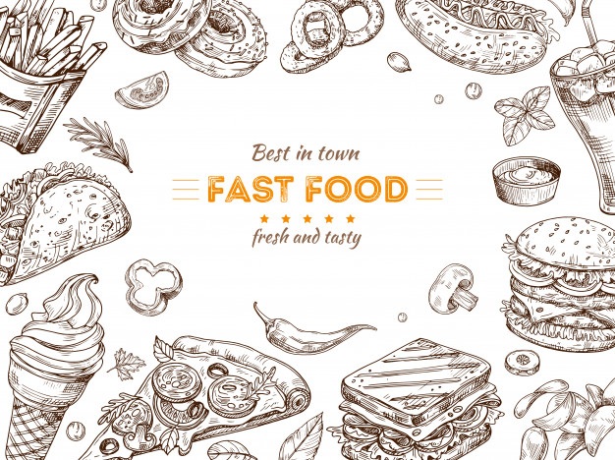


CookWhatAh
ISS-PRSPM-GRP-18 proudly presents:
Start Cooking
CHENG KONG CHEONG
DANIEL TAN HOONG XIANG
YANG JIE SHEN
ONN WEI CHENG
https://www.freepik.com/premium-vector/fast-food-background-sketch-drawing-hamburger-cola-snacks-doodle-ice-cream-pizza-sandwich-fast-food-restaurant-vector-poster_6704376.htm
Notes:
Wei Cheng

Slide 2

CookWhatAh is a Telegram chatbot that allows users to find recipes based on the photos of ingredients taken.
https://www.freepptbackgrounds.net/food-drink/breakfast-powerpoint-template
Notes:
Wei Cheng

Slide 3
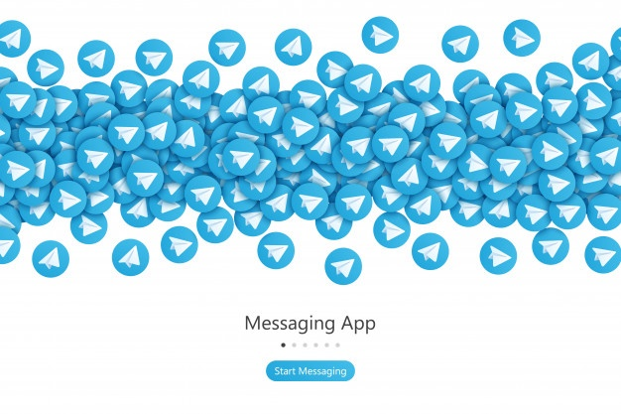

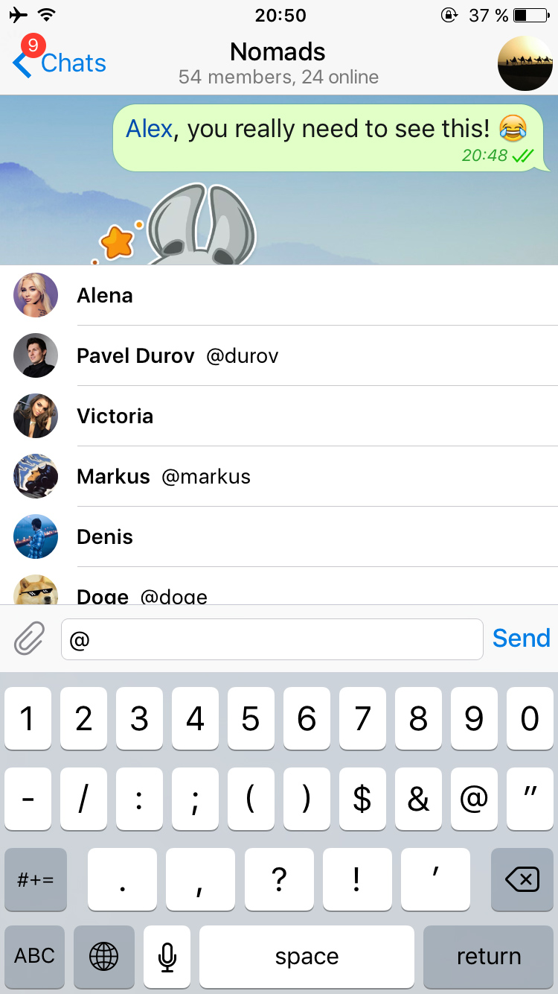

Value Proposition
CookWhatAh
CookWhatAh
CookWhatAh
SAY GOODBYE TO EXPIRED FOOD!!!
WANNA UP YOUR GAME?
DELIVER BEYOND EXPECTATIONS
11:11 AM
11:11 AM
11:11 AM
✔
✔
✔
✔
✔
✔
CookWhatAh find recipes based on photos of ingredients that you have taken
CookWhatAh recommends additional ingredients for you to bring your dish to another level
With step by step instructions and nutritional information, CookWhatAh will be the only “cookbook” you will ever need.
11:11 AM
11:11 AM
✔
✔
✔
✔
11:11 AM
✔
✔
Photos for Chicken & Orange detected. Recommended Recipe: Chinese Orange Chicken.
For the adventurous, add a dash of Sesame Oil to elevate the recommended Chinese Orange Chicken Recipe
For detailed instructions, please visit https://recipe/Chinese-Orange-Chicken
11:11 AM
✔
✔
11:11 AM
✔
11:11 AM
✔
✔
✔
*App simplified for illustration
*App simplified for illustration
*App simplified for illustration
https://www.freepik.com/premium-vector/telegram-start-screen-concept-vector-background_4319339.htm
Notes:
Wei Cheng

Slide 4




System Architecture
Data Gathering & Pre-processing
Model Training
Consumer Journey
Images from user
Bing/Google search image Scrapping
Deep Learning Model
Image recognition
Detection of classes
Bing and Google search are used to search specific ingredients and download the images.
Model: Image recognition model with ~25 classes
Training Data: Images of ingredients
Target: Classes of ingredients
Feature Selection: 2D Convolution with 3 channels
Recipe recommendation
Yummly Recipe Scrapping
Machine Learning Recommendation Model
Ingredient Recommendation
Additional Ingredient Recommendation
Recipes from Yummly are scrapped for their ingredient list
Model: Additional Ingredient Recommendation System based on current ingredients
Training Data: All Ingredients from a recipe less 1
Target: The missing ingredient
Pre-work: Cleaning of ingredients and one-hot encoding
Notes:
Jie Shen

Slide 5
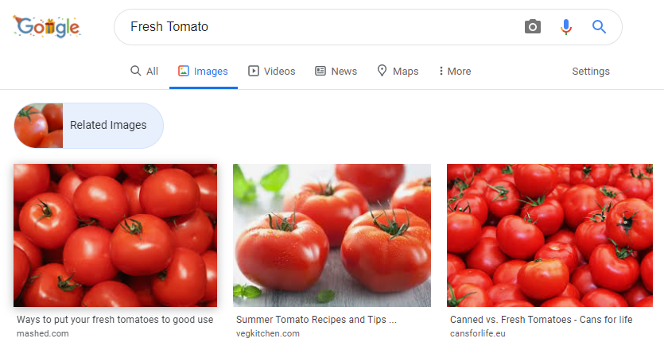
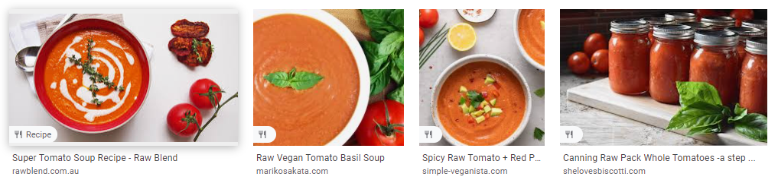
Google Search Image Scrapping
Google Search Engine to extract images for training
Relevant search terms such as “Fresh Tomato”, “Red Tomato” & “Raw Tomato” are parsed into Google search to extract images of ingredient (Tomato) for training
Using of Google related image search
Make use of related images function to get more relevant results
To achieve more relevant results, we made used of the Google related search results. The first image that was found is as an anchor for the related image search.
Images are filtered manually and stored
Results that are not relevant
Information from other sources such as Bing and CIFAR10 are also included to give variability to the dataset.
Notes:
Jie Shen

Slide 6
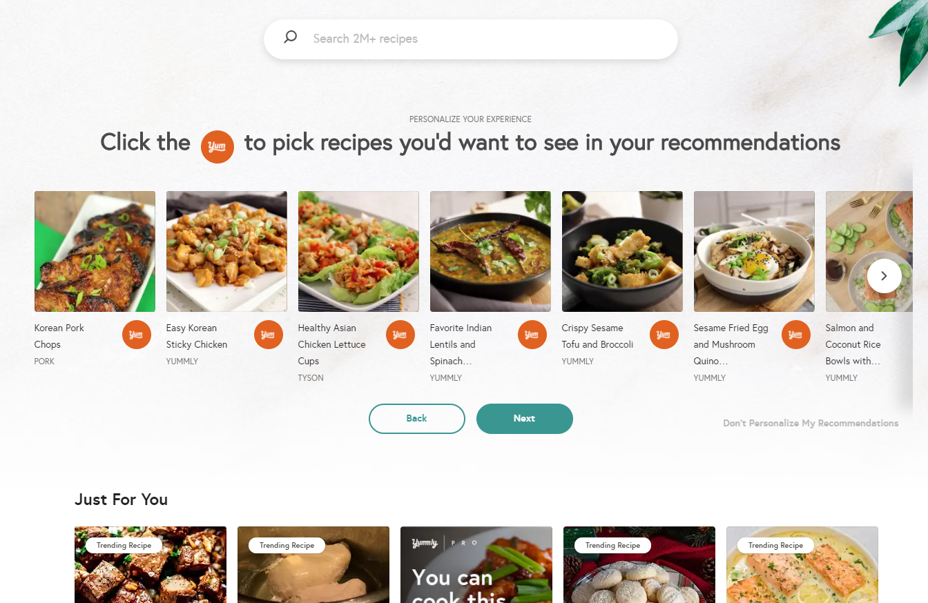
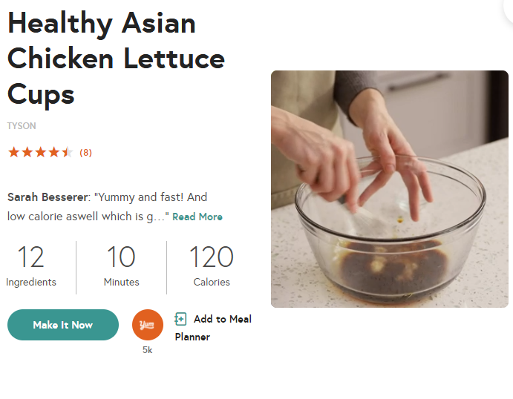
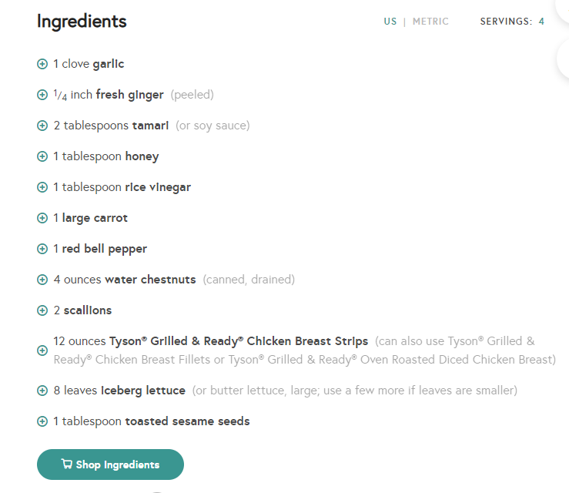
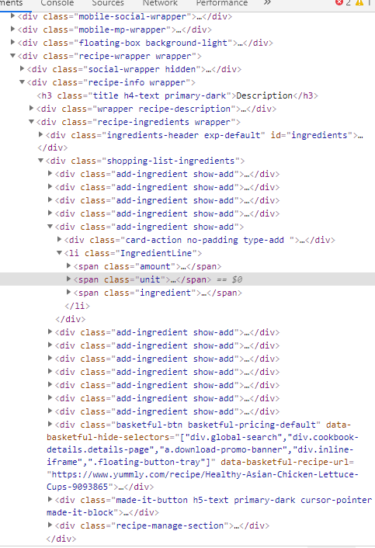
Yummly Recipe Scrapping
Yummly Search Engine to extract relevant recipe links
Links to recipes of interest is extracted by manipulating search terms (input ingredients) in the URL and reading the corresponding HTML tags for the recipe
Rating
Prep Time
Parse the HTML tags of the links
Recipe Prep Link
Ingredient List
Relevant information such as Ingredients, cooking instructions and ratings are extracted using beautiful soup using the html tags
Ingredient information is manually cleaned and stored
Ingredients information from similar categories are combined manually and stored as a spare matrix.
Notes:
Jie Shen

Slide 7
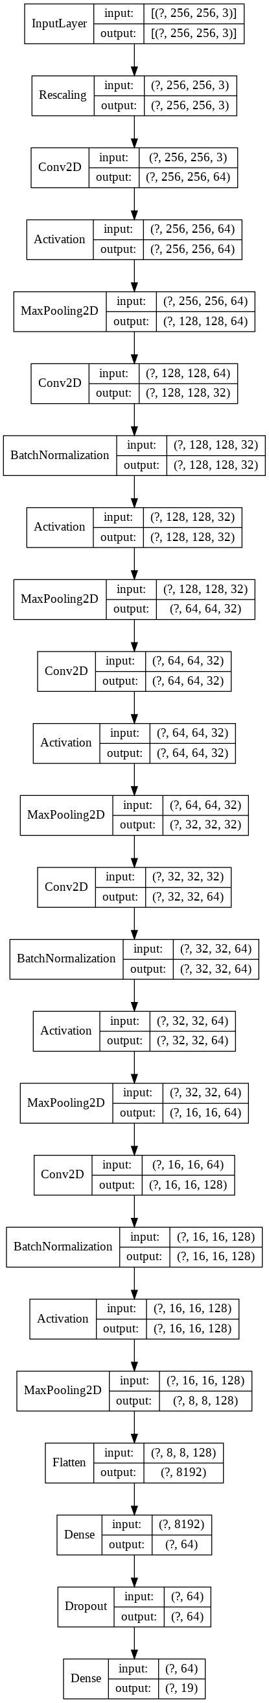
Model Implementation
Image Recognition Deep Learning Model
Input Dataset
Images with corresponding tags obtained from the google image search process is used as the inputs for training.
Images (3 channels) are rescaled and undergo multiple 2D convolution layers (5 Conv2D layers) for feature extraction. Batch normalisation and regularisation are also used.
2D Convolution
Fully Connected Layers
1 hidden fully connected layer is used for classification. Dropout rates, variable learning rates and image augmentation are used to facilitate training.
Output
The output layer with a softmax activation function classifies the image as one of the 25 classes.
*Refer to appendix for model design and accuracy
Notes:
Wei Cheng

Slide 8
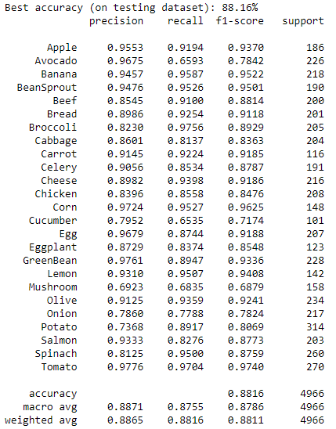
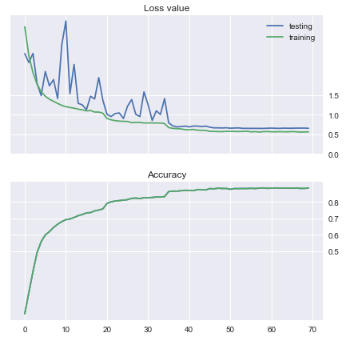
Results and Findings
88% test accuracy
Notes:
Wei Cheng

Slide 9
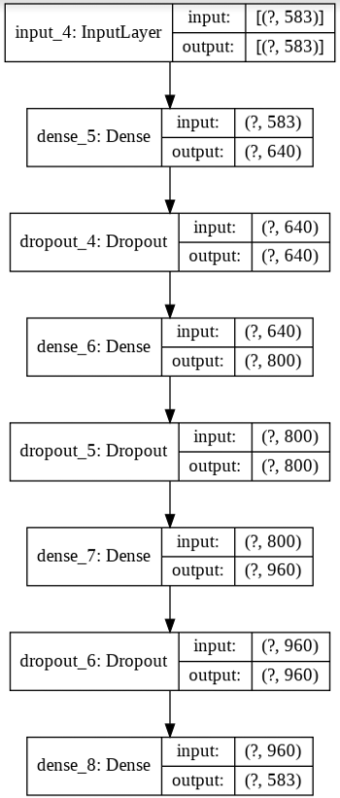
Model Implementation
Additional Ingredient Recommendation System
Input Dataset
Ingredients obtained from Yummly web scrapping is used as the inputs for training.
One-hot encoding
The ingredients of each recipe was one-hot encoded
Train Neural Network
Neural network was trained as an ingredient classifier.
Output
The output of the model (output class) will be the missing/additional ingredient that will elevate the dish.
Notes:
KC

Slide 10
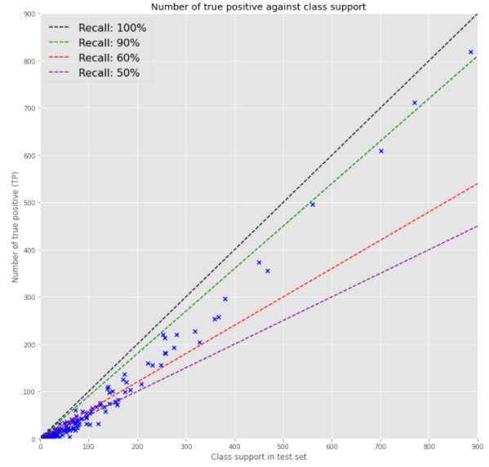
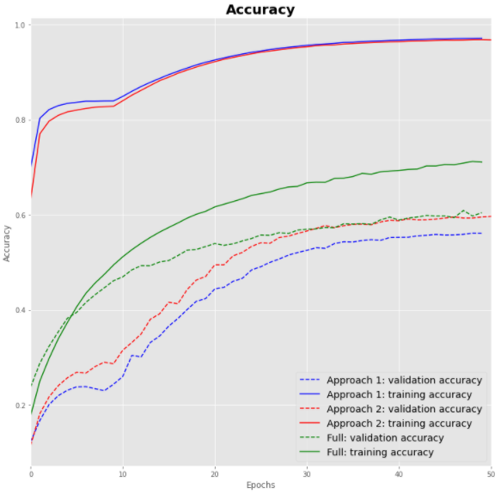
Results and Findings
~ 90% recall for majority class
~ 60% validation and test accuracy
~ 60% - 90% recall for medium class
No drastic change in accuracy when training samples were re-sampled
Notes:
KC

Slide 11
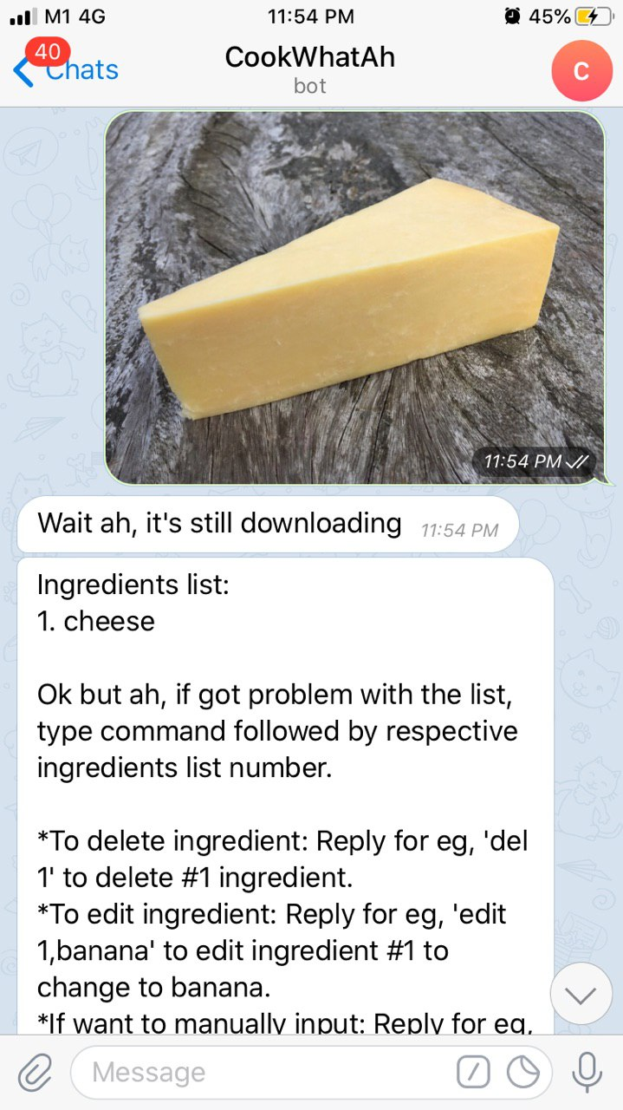
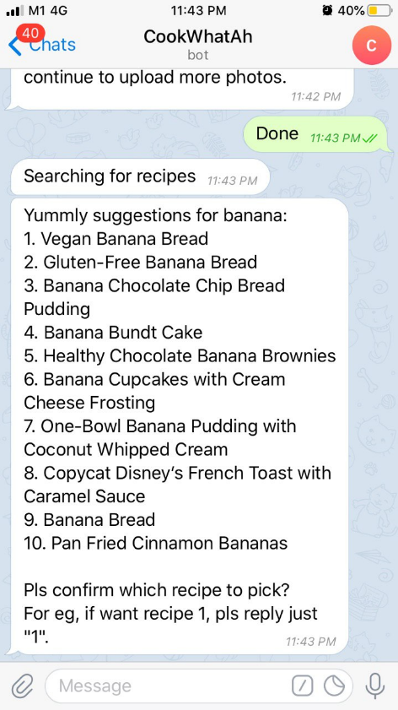
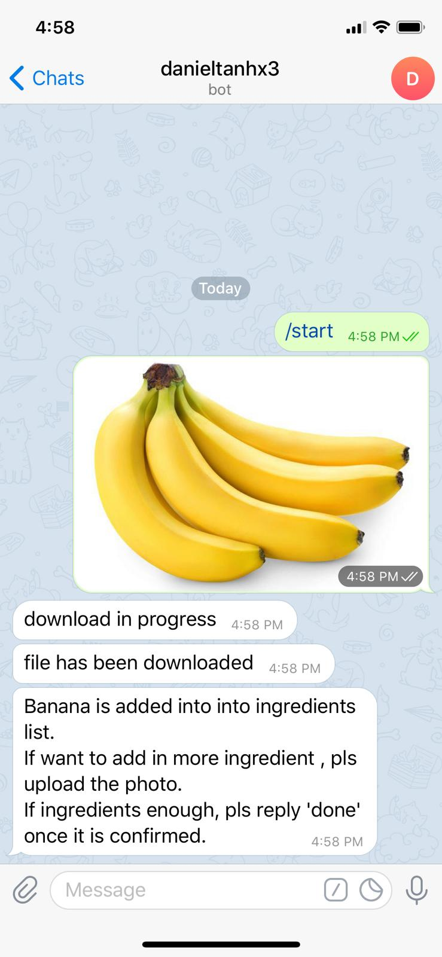
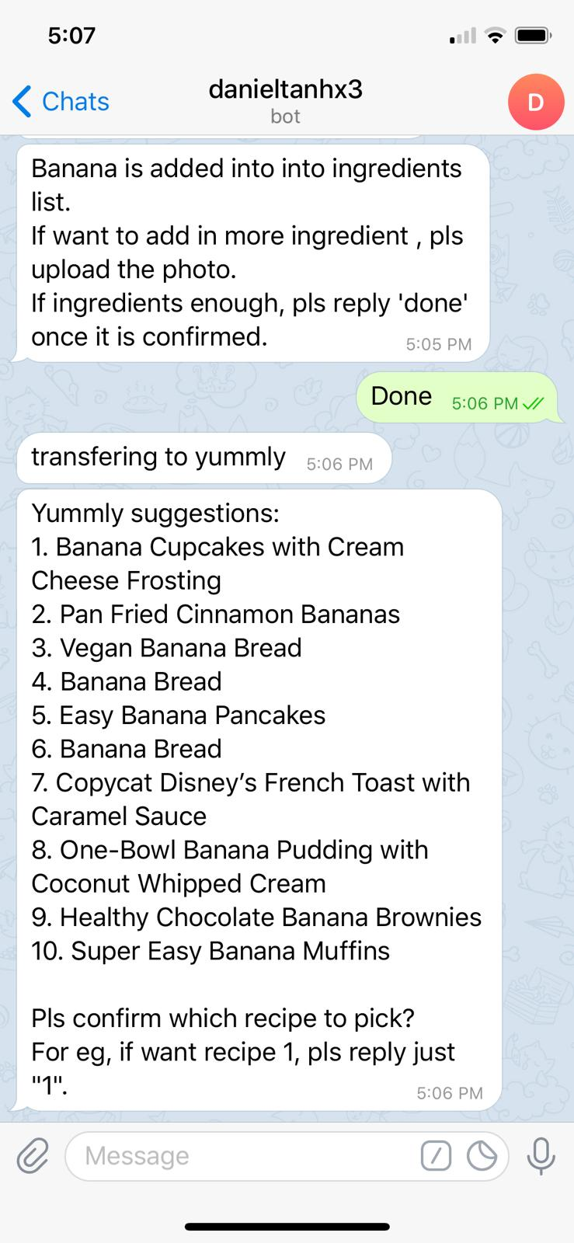
Telegram Integration
Automatically triggered when a photo is uploaded
The image detection process will start immediately when a photo is uploaded and will return the results of the classification
CookWhatAh
CookWhatAh
Users can start recipe recommendations
When all the ingredients are uploaded, the user can start recipe recommendations by replying “done”
Users can choose their recipes
A list of recipes will be shown and the user will be able to choose the recipe that they wish to see
*Actual Reference
*Actual Reference
Notes:
Daniel

Slide 12
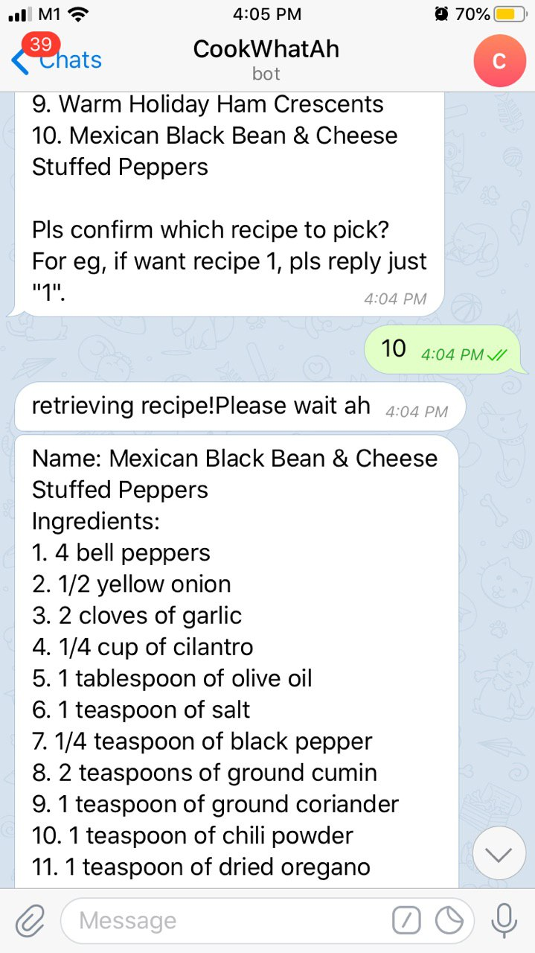
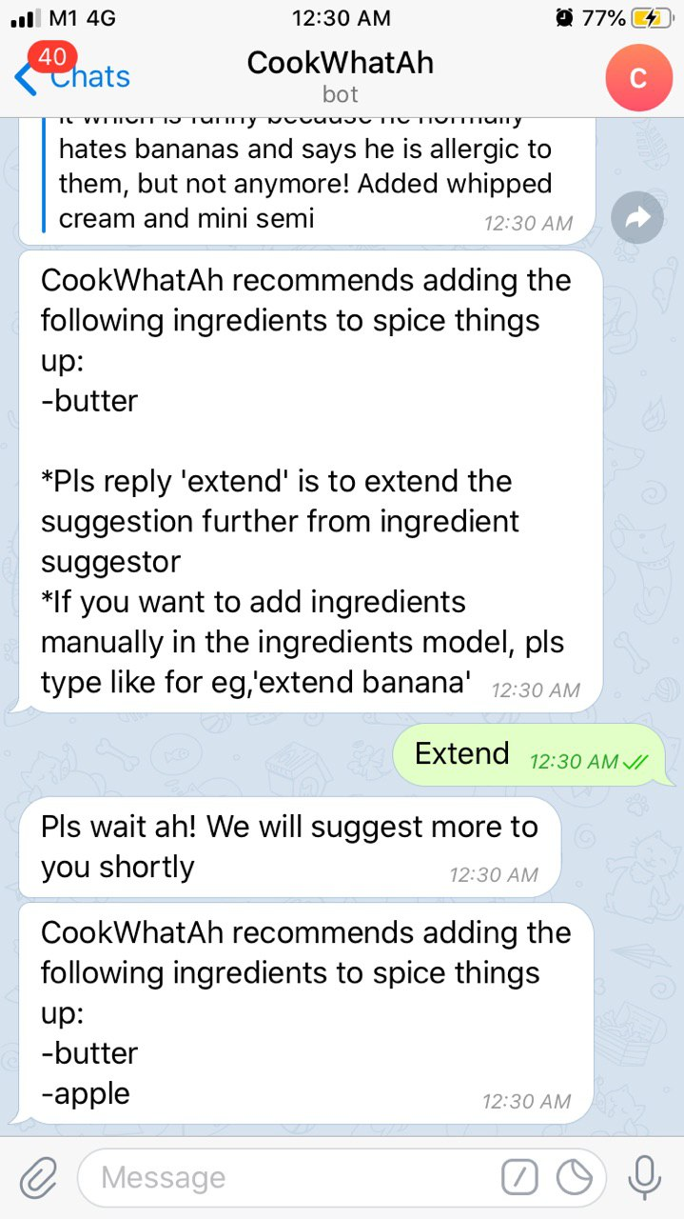
Telegram Integration
Recipes together with the additional ingredient will be shown
After the recipe has been selected, ingredients, cooking instructions and additional ingredients will be shown
CookWhatAh
CookWhatAh
Ingredients suggestion will be given to user
Ingredients model will then be suggesting the user additional ingredients that are predicted to be a good combination
User can extend the suggestion further
Extension of the suggesting recipe will be done to recommend even more to user
*Actual Reference
*Actual Reference
Notes:
Daniel

Slide 13
Conclusion
Data Gathering & Pre-processing
Model Training
Consumer Journey
Images from user
Bing/Google search image Scrapping
Deep Learning Model
Image recognition
Detection of classes
25,000 images scrapped across 25 classes
Achieving 88% accuracy with 25 classes across different categories (Meat, Vegetable, Fruits & Others)
Recipe recommendation
Yummly Recipe Scrapping
Machine Learning Recommendation Model
Ingredient Recommendation
Additional Ingredient Recommendation
6700 recipes scrapped with the minimum of 3.5 star rating
Achieving ~60% accuracy for ingredients prediction
Fully integrated with telegram and hosted on Heroku
Alternative inputs available
Notes:
Daniel

